Slide 1
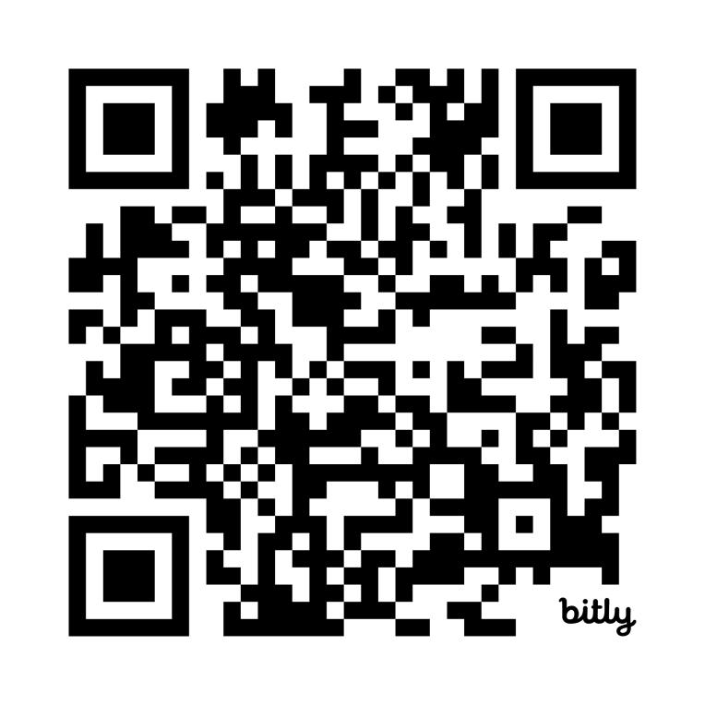
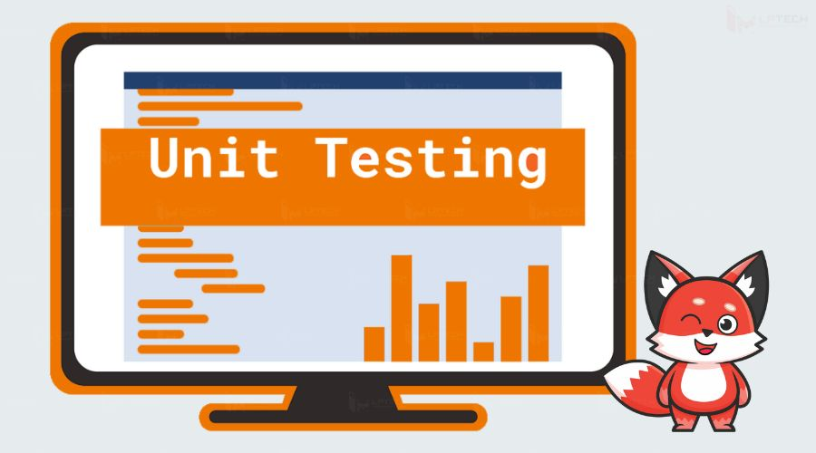
Unit Testing Quiz
https://bit.ly/3YKQK77

